Slide 1


CITS1003 Introduction to Cybersecurity [0] Unit overview
Rob McKnight

Slide 2
3 Things
Understand the objectives and structure of this unit
01
Understand the technical requirements and role of the practical component
02
Understand the “rules” or ethics of cybersecurity and this unit
03

Slide 3
What to Expect
This is an introductory course and so suitable for anyone wishing to familiarise themselves with the terms, concepts and practical aspects of Cybersecurity
There is a theoretical component that involves learning the language, terminology, policies and procedures of cybersecurity
There is a practical component that involves learning command-line tools, operating systems and technical skills used in cybersecurity
There will be minimal coding (unless you want to do more) in this unit and no assumption of prior knowledge in computer science or mathematics
The course is based on CyBOK - the Cybersecurity Book of Knowledge project (https://www.cybok.org/) and some elements of CISSP (Certified Information Systems Security Professional) from ISC²

Slide 4
Emergency
On hearing the evacuation alarm:
Immediately prepare to leave the building -You may secure personal belongings and valuables and bring them with you
Leave the building through the nearest exit. Look for the emergency exit signs and follow through or if you do not know where to go, follow the Lecturer/ Warden’s instruction. DO NOT use the lifts
Walk quickly to the designated assembly area for your building or as advised by a Warden or Fire and Emergency Services personnel.
Remain at the assembly area until given the all clear to return to class
No person is to re-enter the evacuated area until given the All Clear
General emergency: call campus security at 6488 2222
In super emergency: call emergency at 000
For more details, please have a read through the UWA emergency procedure for various potential incidents
http://www.safety.uwa.edu.au/incidents-injuries-emergency/procedures

Slide 5
Assessments
Lectures
Labs
Project
Final Exam

Slide 6
Lectures
In class we will be discussing the theory of cybersecurity and explaining concepts.
During these discussions, it’s a good idea to take notes, especially on language and terminology that may be assessed.
Lecture content will be split up with lab and practical exercises.
The theoretical concepts in the lectures will be assessed in the Final Exam.
The classes will be recorded via Microsoft Teams
PowerPoint slides and pre-recorded videos are available on the LMS.

Slide 7
Labs start in week 1
There are 10 practical labs that we will complete throughout the unit.
Each one is a formative assessment that will teach you some practical cybersecurity skills.
Each lab contains hidden “Flags” that must be found to complete the lab and get the marks for the assessment.
Labs include tasks related to Cryptography, Computing, Threats, Social Engineering, Exploiting Vulnerabilities and more.

Slide 8
Lab Assessment
Labs are worth 25% of assessment.
Each lab is worth of 25 points
10 labs in total are worth of 250 points.
Lab answers can be submitted through the LMS.

Slide 9
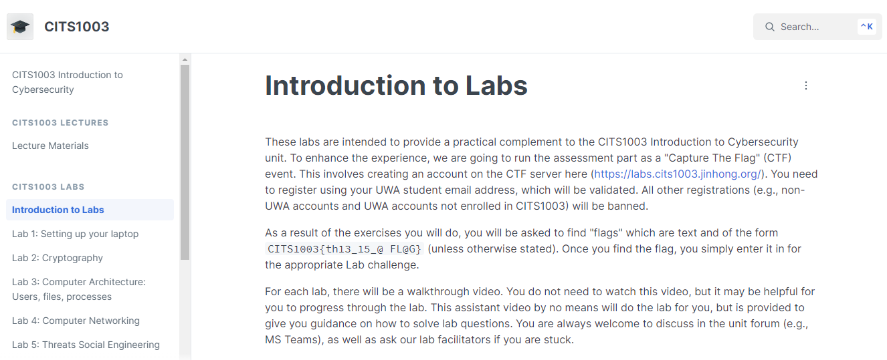
Lab materials are available at https://uwac.gitbook.io/citx1003/citx1003-labs/setting-up-your-laptop (Links to labs can be found on the LMS)

Slide 10
Lab Computer
The labs rely on using an application called Docker and on running virtual machines.
This software must be run on your laptops and a significant part of the unit will require you to use your own computers.
Some of the labs will use a significant amount of Disk space and RAM.
Invest in a decent laptop – it will make a big difference to your University life.
If you don’t have access to a computer for the unit, please come and chat with me.

Slide 11
Lab Help
For labs, we will mostly be working in class. However, you will likely need to spend time outside of class to complete all the lab tasks.
Some labs will take more time than others and you can always ask me for help, either via email: (robert.mcknight@uwa.edu.au) Or through Microsoft Teams.

Slide 12
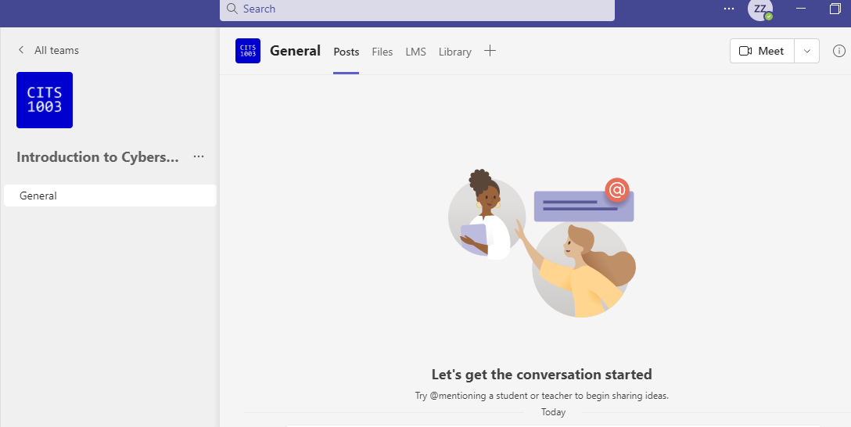
MS Teams

Slide 13
Lab Help
For labs, we will mostly be working in class. However, you will likely need to spend time outside of class to complete all the lab tasks.
Some labs will take more time than others and you can always ask me for help, either via email: (robert.mcknight@uwa.edu.au) Or through Microsoft Teams.
You can help each other but DO NOT share lab answers, only hints.

Slide 14
Lab Due Dates
For labs 1-3, Due end of Week 4
For labs 4-6, Due end of Week 7
For labs 7-10, Due end of Week 11

Slide 15
Lab Setup
Virtual Machine Manager: Virtualbox, Vmware or UTM
Use Kali Linux in a Virtual Machine
Setup VM and do labs there to avoid any mistakes propagating to your host
VM provides an additional layer of security.
Not all labs must run in VM (and is safe to do so on your host machine).

Slide 16
Lab Setup
Container manager: Docker
Docker is used to run small virtual operating systems called “containers.”
Can be installed in a virtual machine (Recommended).
Can alternatively be installed on your host computer.

Slide 17
Other Assessments
Project will be released later in the unit (TBC) and is due in Week 12 (TBC). This will be a series of “Capture-the-flag” exercises similar in format to the Labs
Project is worth 25% of assessment
Final Exam: 50% of final assessment
Exam overview will be done in week 12.
Exam can be assisted by open-book notes without electronic materials

Slide 18
Weekly Topics
Introduction to overall definitions and concepts of cyber security
Cryptography: codes and ciphers
Computers and Networks
Threats
Vulnerabilities
Security management
Incidents
Forensics
Critical Infrastructure and Cyber Physical Systems
Cyber Law
AI and Cybersecurity

Slide 19
Online Resources
You may find David's book on Ethical Hacking with Hack The Box useful
https://book.ethicalhackinghtb.xyz/
Other useful online resources will be provided throughout the weeks as necessary.
Using AI search engines or chatbots might be very useful for the unit but be aware that they may sometimes give incorrect information.

Slide 20
FAQs
Q: Why don’t we get sample answers for labs (and others)?
A:
The lab solutions for this unit can be different significantly from one to another, even with reasonably simple questions.
We simply don’t want you to learn sample answers, but rather learn to explore various ways of solving (i.e., improve problem solving skills).
We (facilitators and lecturers) are happy to discuss your solution, work out what might be going wrong and try to fix it with you.

Slide 21

Cheating
Please don’t cheat on any of the assessment items.
Don’t copy your friend’s code.
Don’t copy code from online.
Don’t share your code structure or flags with your friends
Only share ideas
Consequences are dire!

Slide 22
Information Security
All human endeavour relies on information
Business, Government, Education, Research, Personal life
Information security is about protecting this information from “unauthorised access, harm or misuse”¹
This is done by preserving Confidentiality, Integrity and Availability of information

Slide 23
What is Cybersecurity?
Cybersecurity is a subset of Information Security that concerns the digital realm – so:
Cyber security refers to the protection of information systems (hardware, software and associated infrastructure), the data on them, and the services they provide, from unauthorised access, harm or misuse. This includes harm caused intentionally by the operator of the system, or accidentally, as a result of failing to follow security procedures.¹
CIA is sometimes extended to include Authentication, Accountability, Non-Repudiation and Reliability

Slide 24
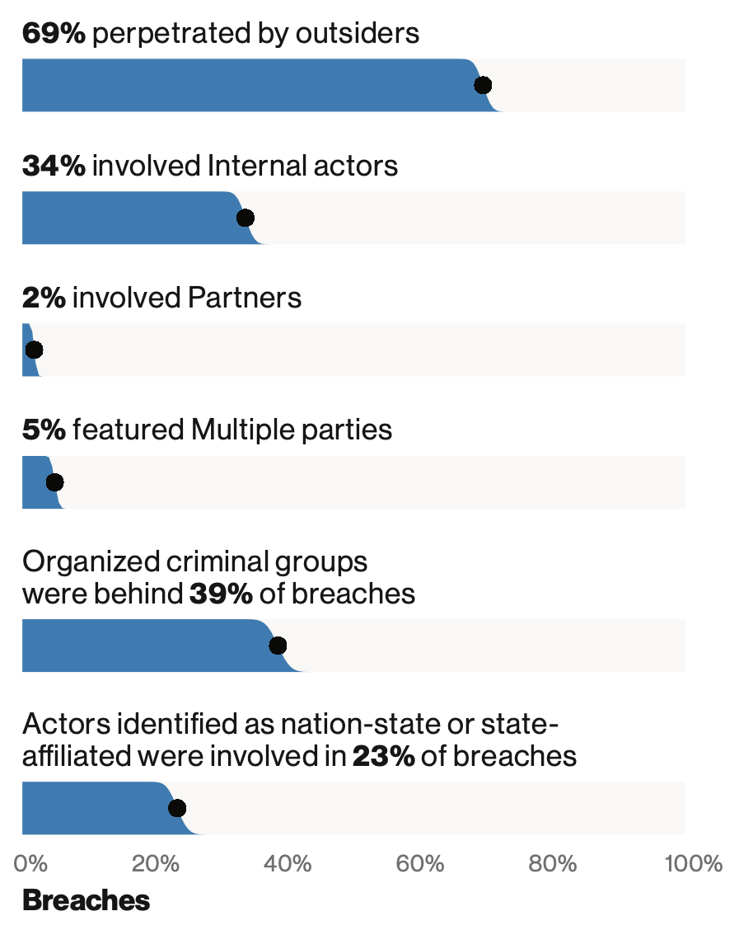
Human Threats
2018 breaches

Slide 25
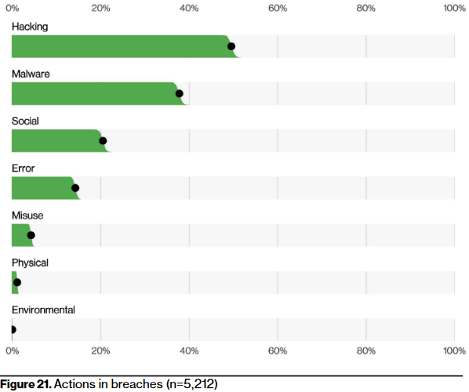
Human Exploits
2022 breaches

Slide 26
Learning Outcomes
To understand and be able to articulate
The language of Cybersecurity
The principles of preserving Confidentiality, Integrity and Availability
Principles of Risk Management
Cybersecurity in the domains of
* Human organisational and regulatory aspects, * Attacks and Defences, * System Security, * Software and Platform Security, * Infrastructure Security
Case studies will be used to illustrate and concretise language, terms and concepts throughout the live lectures
Practical laboratory work will assist in practical aspects of Cybersecurity

Slide 27
Ethics (or what you *absolutely* should not do)
Codes of Ethics are needed by all endeavours that are ”professions”. In cybersecurity, there are several organisations that have them
ISC²
Protect society, the common good, necessary public trust and confidence, and the infrastructure.
Act honourably, honestly, justly, responsibly, and legally.
Provide diligent and competent service to principals.
Advance and protect the profession.

Slide 28
Ethics continued…
Don’t do anything that you don’t have explicit authorisation to do
Hacking without authorization is a crime in almost every country
You can cause damage to yourself and others by being negligent
However, that doesn’t stop you exploring, investigating and learning

Slide 29
Copyright notice
Commonwealth of Australia
Copyright Regulations 1969
WARNING
Materials in this unit (CITS1003 – Introduction to Cybersecurity) have been reproduced and communicated to you by or on behalf of The University of Western Australia pursuant to Part VB of the Copyright Act1968 (the Act).
The material in this communication may be subject to copyright under the Act. Any further reproduction or communication of this material by you may be the subject of copyright protection under the Act.

